Slide 1
EXPLORATORY DATA ANALYSIS
DATA CLEANING, DATA ANALYSIS AND VISUALIZATION OF AN OUTLET SALES DATA

Slide 2
WHAT IS EXPLORATORY DATA ANALYSIS?
Exploratory Data Analysis (EDA)
Descriptive Statistics
Graphical
Data driven

Slide 3
WHY EXPLORATORY DATA ANALYSIS?
Before you begin your analyses, it is imperative that you examine all your variables. Why?
To listen to the data:
To catch mistakes
To see patterns in the data
To find violations of statistical assumptions
…and because if you don’t, you will have trouble later.

Slide 4
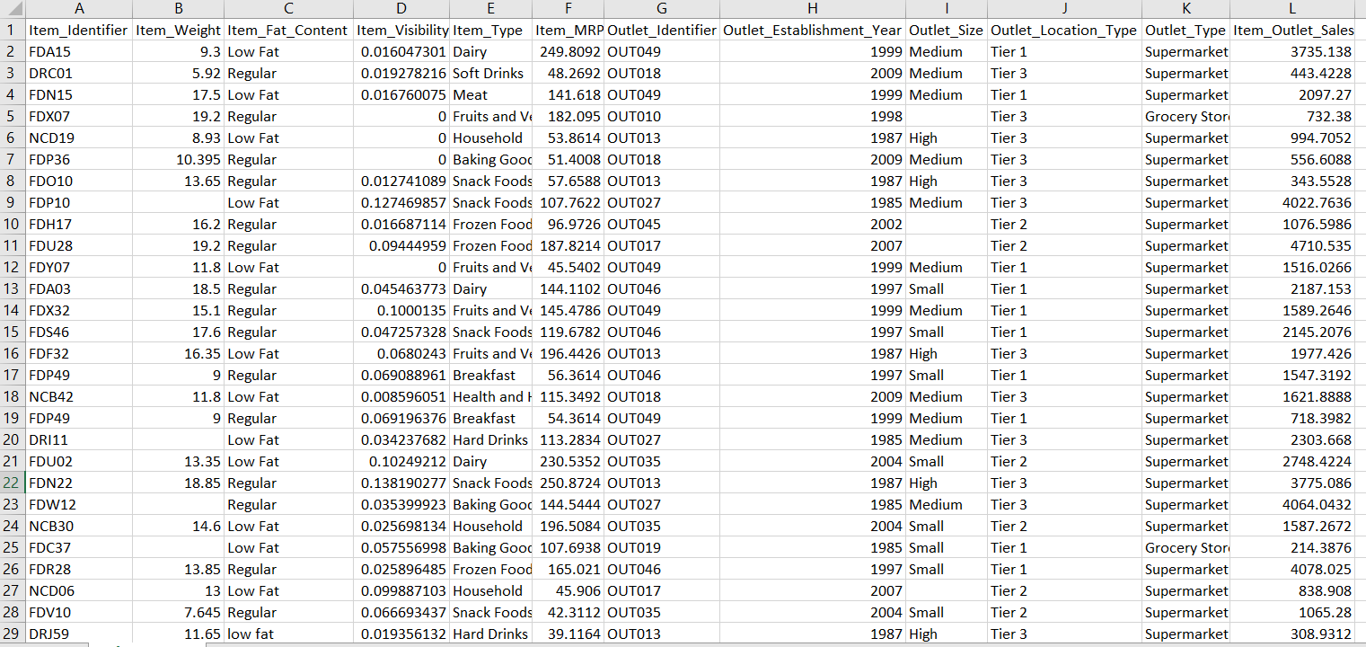
OUTLET SALES DATA

Slide 5
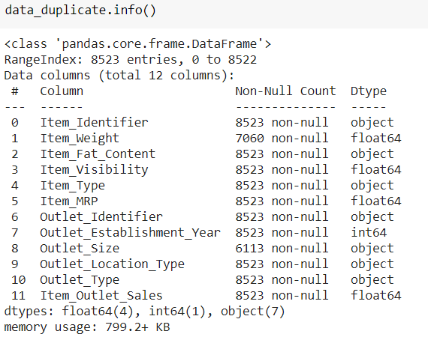
DataFrame with all columns and other info:

Slide 6

PANDAS PROFILING STEPS
Profiling refers to the activity of creating small but informative summary of a dataset.
Managing the input.
Performing the Computation.
Managing the Output.
Note: Pandas allow to read into memory different dataset types like Excel, Feather, CSV, Parquet, Databases and More...

Slide 7
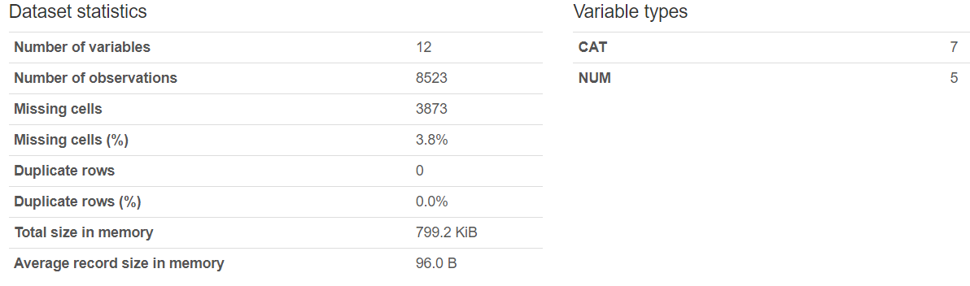
PANDAS PROFILING REPORT: OVERVIEW

Slide 8
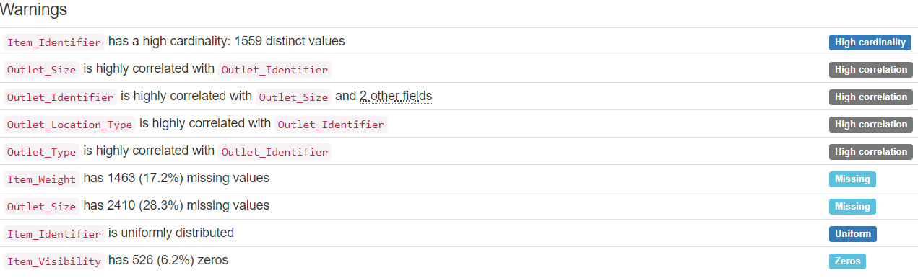
PANDAS PROFILING REPORT: WARNINGS

Slide 9
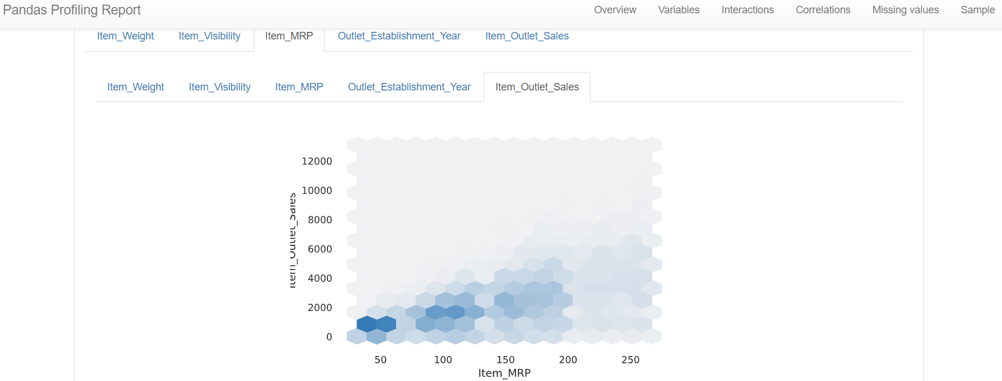
PANDAS PROFILING REPORT: INTERACTIONS

Slide 10
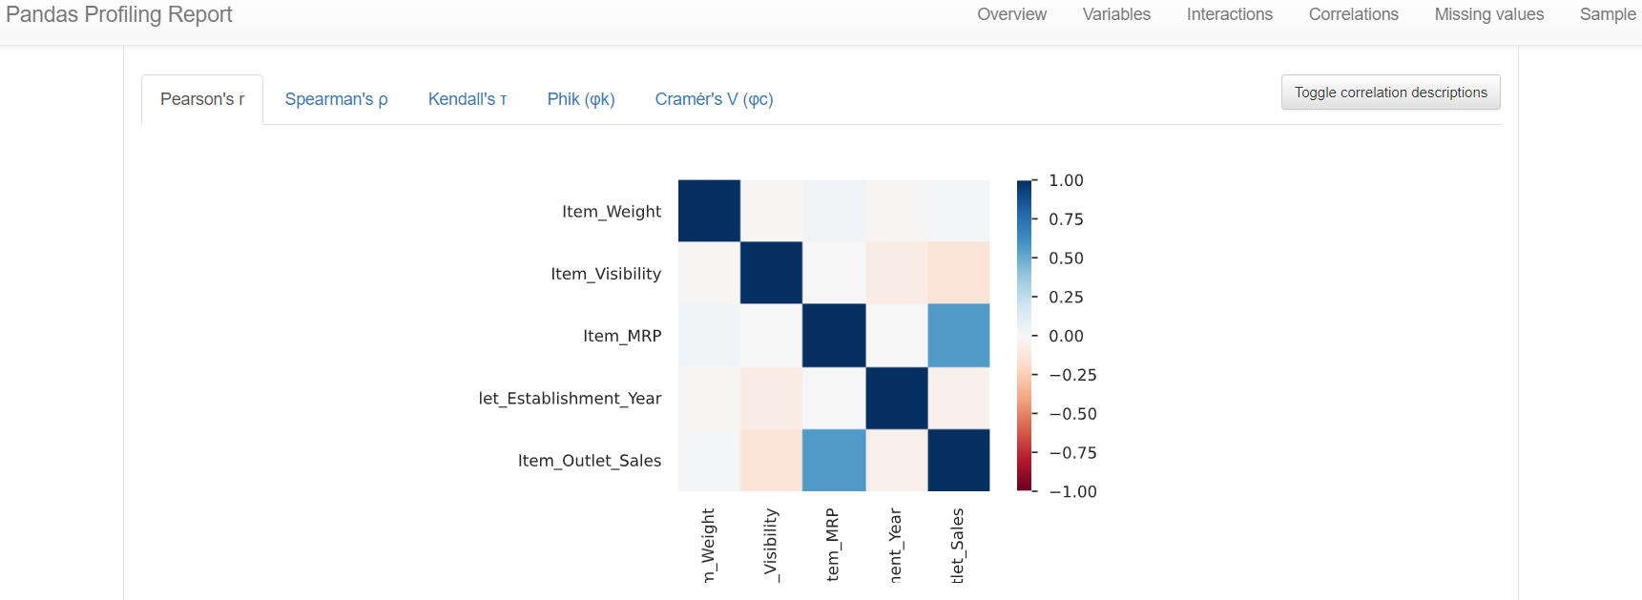
PANDAS PROFILING REPORT: CORRELATIONS

Slide 11
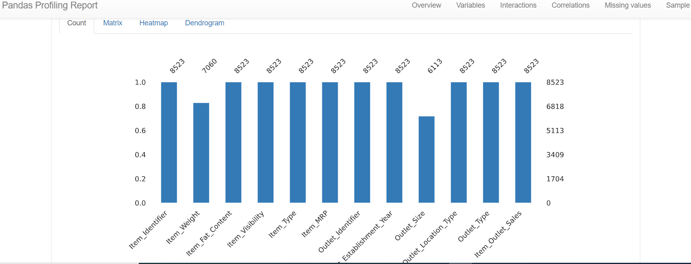
PANDAS PROFILING REPORT: MISSING VALUES

Slide 12
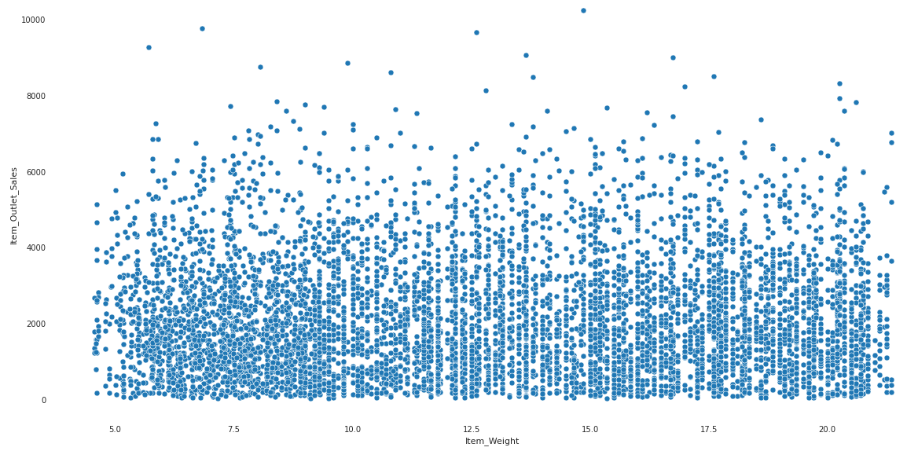
EDA: Item Weight vs Item Outlet Sales:
Conclusion: By the above graph we conclude that there is no pattern or correlation between item_outlet_sales and item_weight.

Slide 13
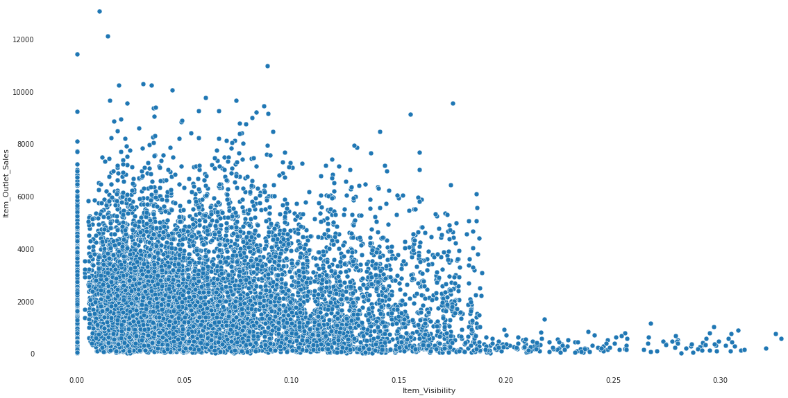
EDA: Item Visibility vs Item Outlet Sales:
Conclusion: High visible or easily accessible item are more sold out when compared to less visible that means this attribute makes some inference to the target variable.

Slide 14
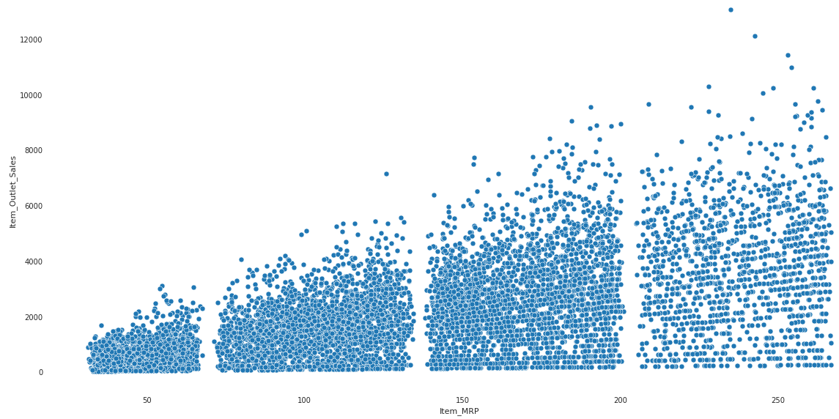
EDA: Item MRP vs Item Outlet Sales:
Conclusion: High range of Item_MRP has more sales when compared to low range of Item_MRP so this attribute also makes some inference for the target variable.

Slide 15
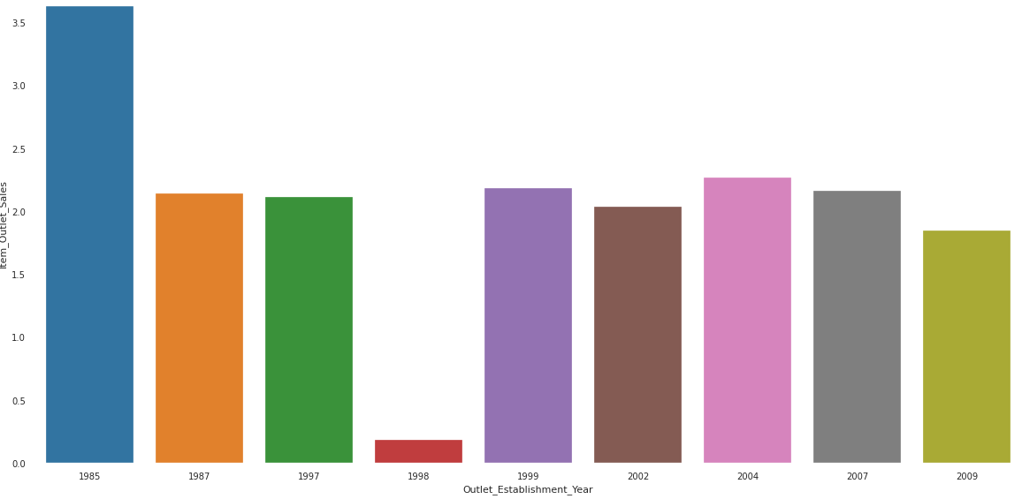
EDA: Outlet Establishment Year vs Outlet Sales:
Conclusion: There is no much inference with respect to outlet establishment year, hence it is less significant.

Slide 16
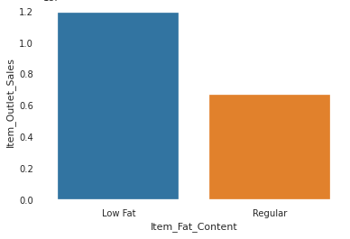
EDA: Item Fat content vs Item Outlet Sales:
In the data, there are four categories of Item_Fat_content, 'LF' and 'low fat' are same and so Regular and reg. So After changing these respective values. The graph is as shown below:
Conclusion: Low Fat Content items have higher item_outlet_sales.

Slide 17
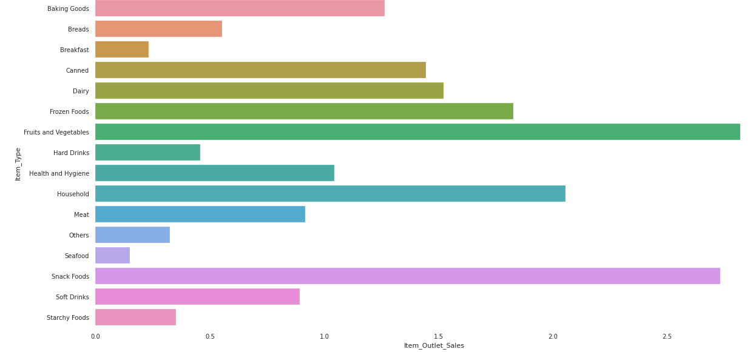
EDA: Item Type vs Item Outlet Sales:
Conclusion: Fruits and Vegetables, Snack Foods constitute the highest of item_outlets_sales.

Slide 18
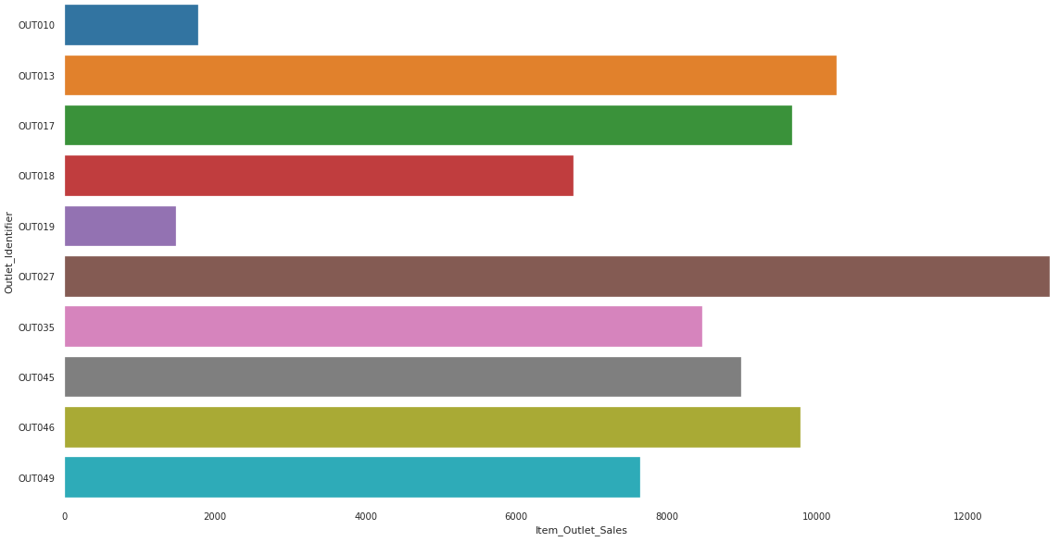
EDA: Outlet Identifier vs Item Outlet Sales:
Conclusion: Outlet OUT027 have highest item_outlet_sales.

Slide 19
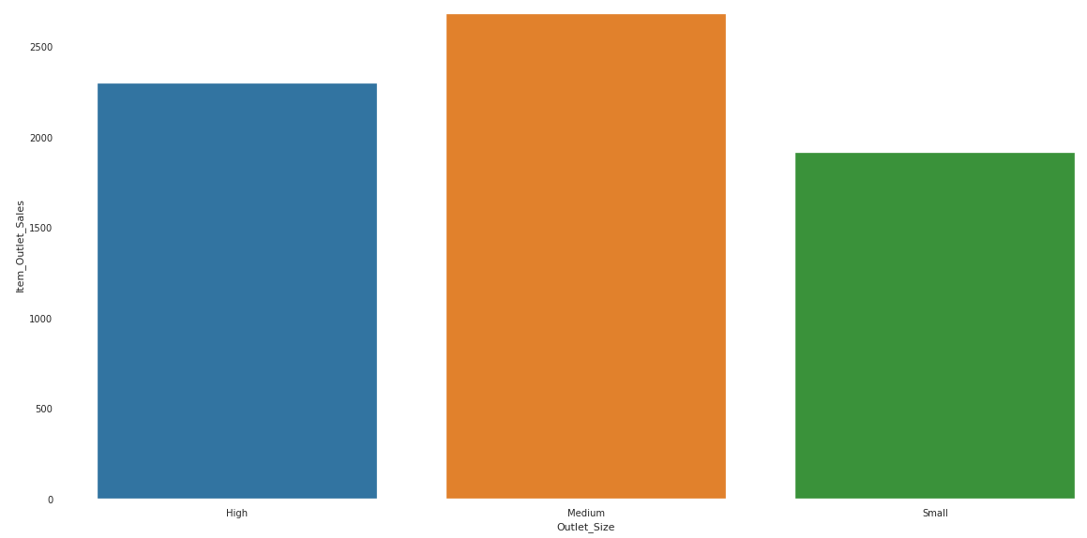
EDA: Outlet Size vs Item Outlet Sales:
Conclusion: Medium sized stores have high item_outlet_sales.

Slide 20
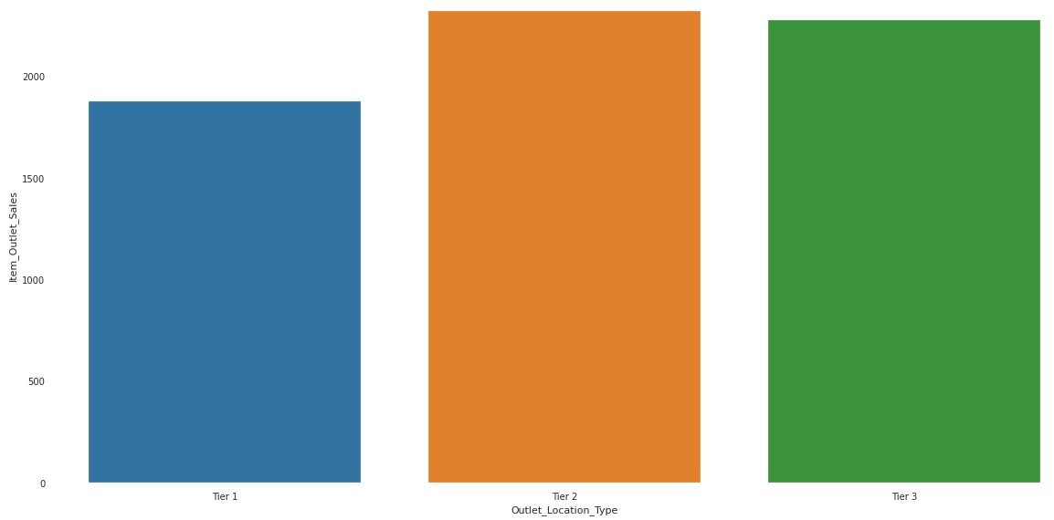
EDA: Outlet Location Type vs Item Outlet Sales:
Conclusion:Tier 2 cities avg sales are higher than tier 3 and tier 1 cities.

Slide 21
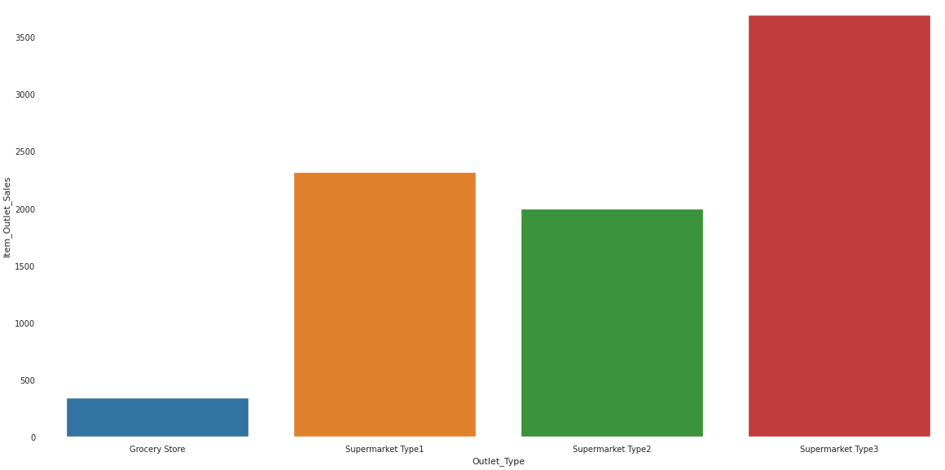
EDA: Outlet Type vs Item Outlet Sales:
Conclusion: Super_market_Type3 has the highest average sales out of the others.

Slide 22
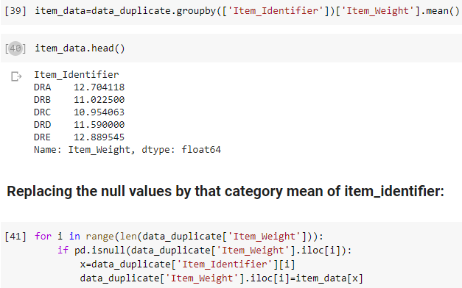
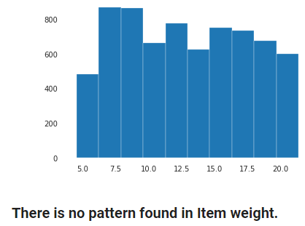
Imputing null values of the Item_Weight:
Reducing the item_identifier:

Slide 23
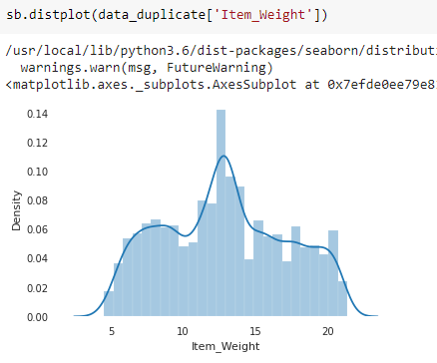
After Imputing null values of the Item_Weight:

Slide 24
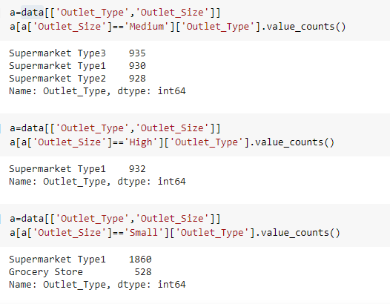
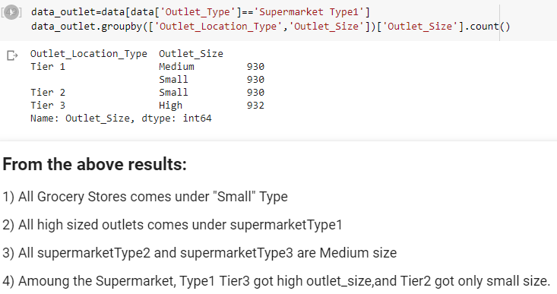
Imputing null values of the Item_Size:
Finally, Replace the null values according to the above results using python logic.

Slide 25
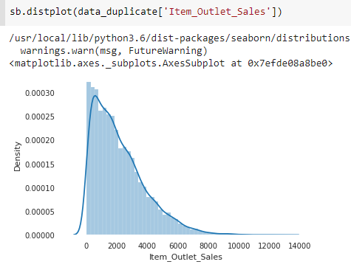
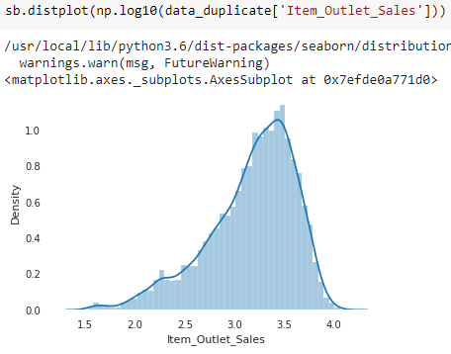
Model Building: Regularization models.
Conclusion: As we can observe here that Item_Outlet_Sales is right skewed so it is better we use logarithm transform but after using the log transformation

Slide 26
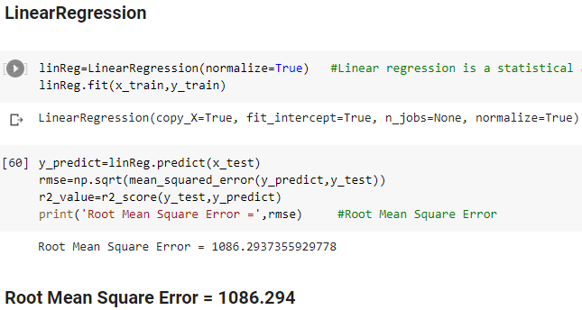
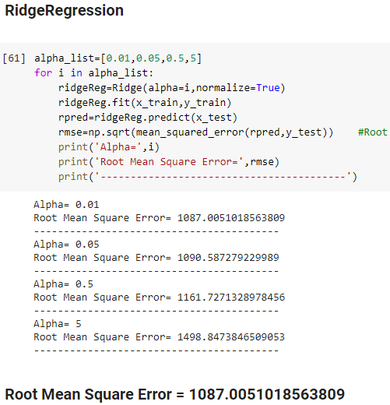
Model Building: Regularization models. Contd...

Slide 27
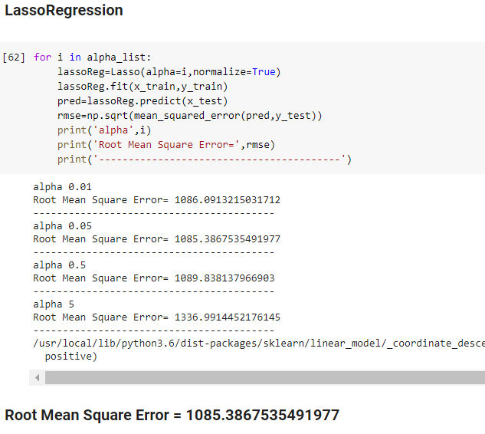
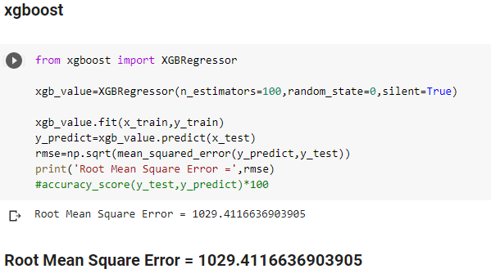
Model Building: Regularization models. Contd...

Slide 28
Final Report:
'Outlet_Establishment_Year','Item_Weight','Item_Visibility' are the insignificant columns to predict the item-outlet sales,as discussed in the EDA above.
Item_outlet_sales was rightly skewed,so taking the logarithmic transformation increased the R-squared value.
Xgboost model gave the least RMSE(1029.4116636903905) value so this model is selected.
Predicted values are log-values and should to get the actual value one should take the inverse.

Slide 29
EXPLORATORY DATA ANALYSIS
THANK YOU!

